Slide 1
Service Quality Standard
Calculations and Predictions
Charlotte Parliament- Literacy and Essential Skills Program Coordinator
(Adapted from Frontier College)

Slide 2
What exactly is the
Service Quality Standard (SQS)?
How is the SQS calculated?
Predictions and Tools

Slide 3
What is an SQS?
According to MTCU:
Simplified:
The SQS is a combined statistic that offers a summary of how well a program is doing in all areas measured by MTCU

Slide 4
What is an SQS?
All SQS information can be found on page 3 of the monthly Detailed Service Quality (DSQ) report
It provides a summary of how a program is performing in terms of YTD targets, provincial standards and ministry expectations
It provides details on how each aspect of a program is weighted for scoring
It shows details about how future phases will impact program statistics (Phase II-B)

Slide 5
Get out your calculators…

Slide 6
Sample SQS
Target score set by MTCU
Current scores for your program
Weighting for individual program criteria

Slide 7
SQS at a Glance
Current score for your program
Target score set by MTCU
You can compare the with the to get a quick view of which areas need attention
For example, if the Target score for suitability is and your SQS current score is , you immediately know that area is not meeting expectations
Likewise, if your current score is the same or higher than the target value, that area is not hindering your SQS score
Most importantly, the SQS report shows you what areas are weighted highest in calculations
.60
.53

Slide 8
SQS and Weighting
In theory, the areas that are weighted the highest by the MTCU are also the areas that should be focused on when attempting to increase an SQS. But it’s not that simple…
Notice that Suitability is weighted 20% but only targeted at a value of .60, whereas Customer Satisfaction is weighted at a lower 15% but is targeted at a value of 1.35. Despite weighting, changes to Customer Satisfaction will impact your SQS more directly (generally).

Slide 9
SQS Calculations
The SQS for each area is determined using the following formula:
(YTD Actual Percentage / 100) x (SQS weighting/100) x 10 = SQS

Slide 10
SQS Calculations
[(YTD Actual Percentage / 100) x (SQS weighting percentage/100) (for the selected area)] x 10 = SQS
If we use Progress as a sample, the previous slide shows a YTD Actual percentage of 57% and a SQS weight of 30%. Using the formula, we get:
(57/100) x 30/100] / 10 = 1.72 SQS
Note: 57% was rounded from 57.4% for 1.72 instead of 1.71
This result usually matches the SQS shown on the latest DSQ without rounding ☺

Slide 11
Customer Satisfaction
# of closed LBS plans with a 4 or 5 service rating
______________________________
# of closed LBS plans with a 1-5 service rating
Service Coordination
# of plans with one eligible referral option selected
______________________________
# of closed service plans YTD
Learners
Served
# active learners YTD
__________
# Prorated target for learners served
Suitability
# of suitability factors associated with YTD closed LBS plans
______________________________
# of closed service plans YTD
Progress
# of service plans with ≥ 1 competency milestone "attained“
______________________________
# of YTD closed AND active LBS service plans

Slide 12
Sample SQS calculation
What would the SQS score be for a program that had a YTD 57% value in Customer Satisfaction if the SQS weighting for Customer Service is 15%
The SQS weighting for Suitability is 20%. What would the SQS score be for a program that had a YTD 33% value in suitability?

Slide 14
12

Slide 15
Maximum SQS

Slide 16
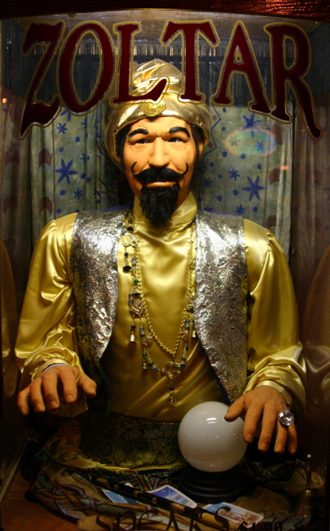
SQS Predictions
YTD Actual Percentage / 100 x SQS weighting/100 x 10 = SQS
For predictions, you can use this formula to check how changes in your program will impact the overall SQS. For example, if 63% was the YTD actual percentage for progress, the SQS would increase to…
[(63/100) x 30/100] x 10 = 1.89 SQS
These predictions take time, particularly because you need to first calculate the YTD %. So it is more effective to use a tool…

Slide 17
Predicting
Excel Spreadsheet with formulas for predicting SQS

